Slide 1
Customer-Based Corporate Valuation II:
Modeling Overall Customer Base Activity

Slide 2

Recall how CBCV works
Acquisitions
Acquisitions
Acquisitions
Date
Q1
Q2
Q3
Customers
Churn
Churn
Purchase frequency, basket size
Sales
$100
$200
$350
Contribution margin, CAC, fixed costs, balance sheet effects
Free Cash Flows
$50
$100
$175
WACC
PV(FCF’s)
$49
$148
$171
NPV(FCF’s)
$368
Non-Operating Assets, Debt, Shares Outstanding
E(Stock Price)
$25
Specify generative models for acquisition, retention, ordering, and spend
Notes:
Implicitly assumes the underlying valuation method is DCF… but works with ~any other valuation method “for free”

Slide 3
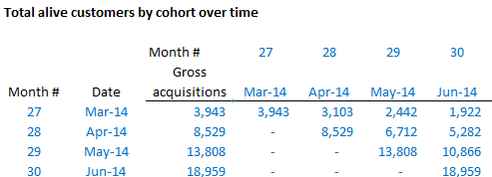
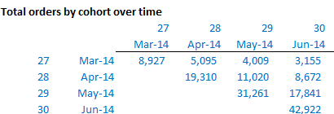
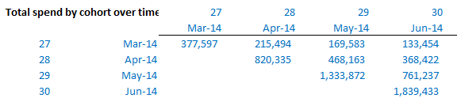
Translating framework into data
Acquisition
Retention
Ordering
Spend

Slide 4
Simplifying assumptions for today’s lecture
Assume:
Subscription firm
Customers are acquired at the end of each quarter
Revenue is generated at end of each quarter for customers
Cohorted customer data and total revenue data are available
Focus upon retention and spending
Assuming acquisitions are given
Notes:
Not just one cohort!
Draw picture of timing of acquisition and revenue.
0, 1, 2, …
Lines at 1, 2, “acquisitions(q1)”, “acquisitions(q2)”,…

Slide 5
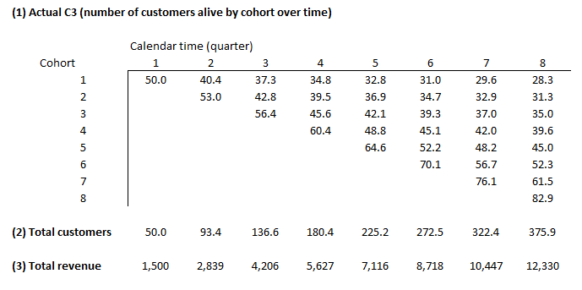
The Data

Slide 6
Modeling retention across cohorts
Set up expected cohorted customer data as function of parameters
Estimate retention parameters
Can be cohort-specific, or over all previous cohorts (may be necessary when data is more limited)
One model for all previous cohorts: necessary when data is more limited
Let’s run the numbers a few ways…
Notes:
Pull up spreadsheet to show column sums
Cohort-specific model off the C3
One model off the C3
Modeling off of total customers instead of the C3

Slide 7
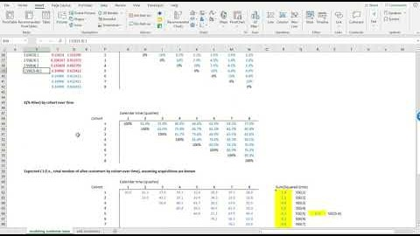
Modeling retention across cohorts
Notes:
Pull up spreadsheet to show column sums

Slide 8
Modeling total revenue
Set up expected ARPU data as function of parameters
Convert expected ARPU into expected revenue
Estimate spend parameters by minimizing difference between actual and expected revenues

Slide 9
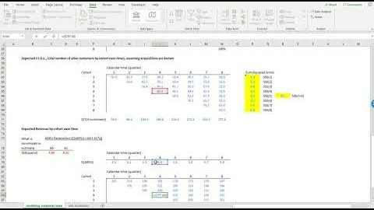
Modeling total revenue

Slide 10
Extracting cohort-level unit economics
Required assumptions:
Discount rate
Variable margin
CAC for each cohort

Slide 11
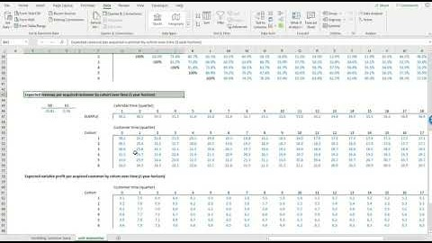
Extracting cohort-level unit economics

Slide 12
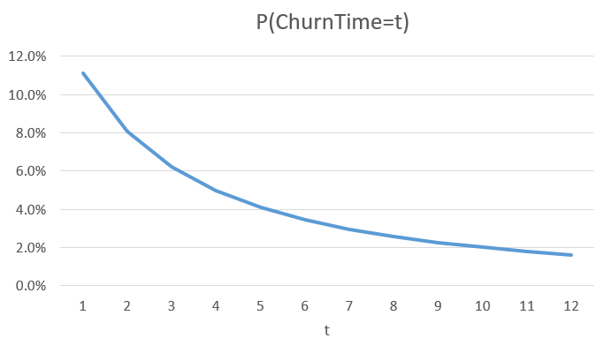
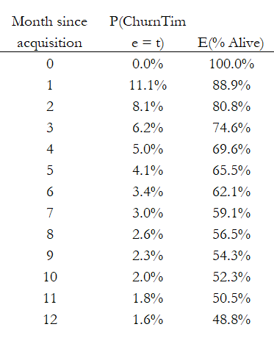
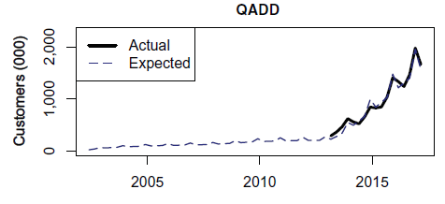
What about acquisitions?
Incorporating acquisitions – same as retention…
But slightly more complicated statistical model
Notes:
Cross out acquisition, replace with prospect
Cross out ChurnTime=t, replace with AcquisitionTime=t
Cross out E(% Alive), replace with Cumulative % of prospects acquired
P(AcqTime) moves up not down. sBG can’t have an increasing P(acquisition) – at best flat.

Slide 13
Further extending the framework
Non-subscription firms? Use the BG/BB instead of sBG
Other/different data? Change “SSE” that we estimate parameters from
Covariates? ~Simple extension of the statistical model
Cohort-specific and/or time-varying ARPU and margin trends?
Notes:
Replace vector ARPU and scalar margin % with matrices
Simple pictorial description

Slide 14
Comments about the tutorial
First time using this: feedback welcome!
“Weibull Gamma” model for acquisition and retention: think of this as a “better sBG” – give me parameters, I give you per-period probabilities
Can capture acquisition and retention data very well
We do full discounted cash flow (DCF)-based valuation

Slide 15
Lessons
Modeling overall customer base activity isn’t that much worse!
Use all the same tools, but run models across cohorts, then sum across those cohorts

Slide 16
Optional additional resources
“Valuing Subscription-Based Businesses Using Publicly Disclosed Customer Data” (link), McCarthy, Fader, and Hardie, Journal of Marketing, December 10, 2015

